Slide 1

Accounting in
Business

Slide 2
Learning Outcomes
Classify economic events of organizations with respect to recording in books of accounts.
Comprehend the process of accounting.
Recognize the objectives, advantages and limitations of accounting.

Slide 3

Contents
Introduction to Accounting
2. Accounting Process
Objectives
Advantages
Limitations

Slide 4

What is Accounting???

Slide 5
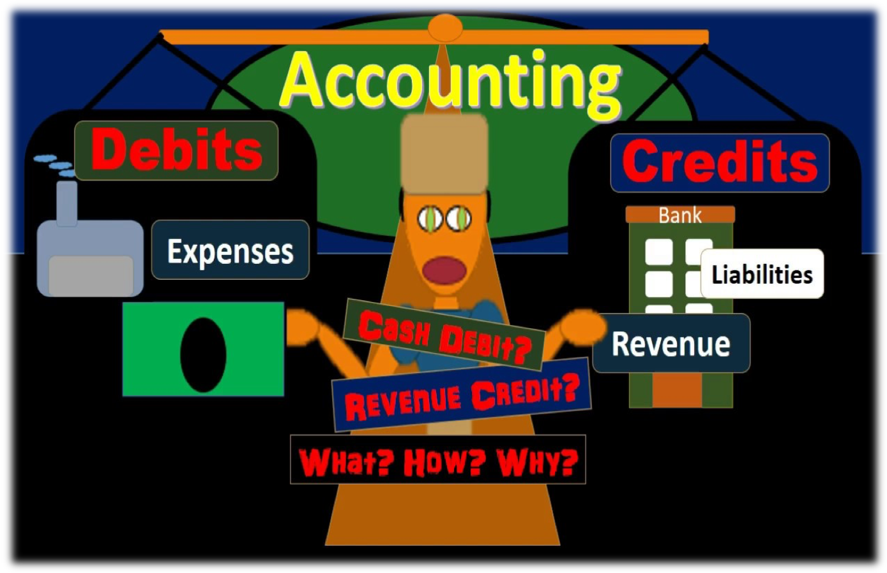

Slide 6
What is this going on???

Slide 7
What actually accounting is???
Accounting is the recording and summarizing business and financial transactions and analyzing, verifying, and reporting the results.

Slide 8
Business and Financial Transactions
Accounting is primarily concerned with the measurement and valuation of economic events.
But all events may not be economic events and are not considered as business and financial transactions for recording purpose.

Slide 9
Let’s learn Accounting in systematic manner with a case….

Slide 10

Case- Economic Events/Financial Transactions
Mr. Salman is the owner of a coffee house.

Slide 11
Cont…
The Coffee House also has the menu of specialty sandwiches, flatbreads, Veggie wraps, and bakery items for breakfast, lunch, and dinner along with quality coffee drinks.

Slide 12
Cont…
On 1st August 2019 Mr. Salman bought coffee beans, brown bread and vegetables for Rs. 7,000.
On 1st August 2019 Mr. Salman sold 100 coffee cups for Rs. 100 each.
On 2nd August 2019 He went to Chandigarh for business meeting.
He came back on 3rd August 2019 and on the way he spent Rs. 2000 on petrol for official motorcar.
On 4th August 2019 he purchased Milk, coffee powder, icing sugar and other material for Rs. 3,000.
On 5th August 2019 he received Rs. 5,000 for coffee and snacks which was served at customers' birthday party on the same day.
Notes:
Give following instructions to students:
Ask students to identify business transactions
Measure the transactions
Show how to record it in books
Show how to Classify the transactions
Make summary of it
Ask them to analyze the summary

Slide 13
Cont…
On 6th August 2019 he appreciated his employees for putting their hard work to complete target well on time.
Is there any financial transaction involved in the above case??

Slide 14
Conclusion
Events which occurred on 2nd and 6th August are not considered to be economic events and cannot be recorded as business and financial transactions.

Slide 15
Accounting Process
Identification of transactions/events
Measurement of transactions
Recording of financial transactions/events
Classification of recorded transactions/events
Summarization of classified transactions/events
Analysis & interpretation of summarized reports
Communication of analyzed & interpreted reports

Slide 16
Case-Steps involved in Accounting Process
Epson Ltd. is the dealer of computers and printers. It has an extensive range of Multifunction printers which it used to buy from HP for Rs. 5000 for resale purpose. It shows this purchase in the financial statements as an expense to the business.
Now, a purchasing manager looked into the expense at the year-end and recommended (the owners) a few cheaper alternatives to be considered for all future purchases.
Identify the steps involved in accounting process in the above mentioned case.

Slide 17
Solution
Process step | Explanation of the steps
Identify | The transaction “identified” was the purchase of a printer.
Measure | The cost of the printer was “measured” as 5000.
Record | The transaction was “recorded” in books systematically as 5000.
Classify | The transaction was then moved to the ledger and “classified” with similar transactions.
Summarize | Here the ledger balance was “summarized” and converted into trial balance and financial statements accordingly.
Analyze | Purchase manager “analyzed” the financial statements at year-end.
Interpret | The analysis lead to the “interpretation” that the printer was costly and cheaper alternatives were available.
Communicate | This was “communicated” to the owners as a recommendation for future purchases of this kind.

Slide 18
Importance of Accounting
is a
system that
Accounting
Identifies
Records
information
that is
Relevant
Communicates
Reliable
about an organization’s business activities.
Comparable
1-18
Notes:
Accounting is an information and measurement system that identifies, records, and communicates information that is relevant, reliable, and comparable about an organization’s business activities. The goal of the accounting process is to provide helpful information to users of financial information. Quality information may help users reach more informed decisions.

Slide 19
In the business world, accounting is utilized in much greater depth, but each individual encounters some activities in his/her everyday life that requires knowledge of accounting principles.
Most basic framework of business.
Without an accounting education, students would be unprepared for the real world.

Slide 20
Objectives of Accounting
To maintain a systematic record of business transactions
Transactions are recorded in chronological order in ‘Journal’ and then posted to principle book i.e. ‘Ledger’ (recording of transactions group wise).

Slide 21
To ascertain results
In order to ascertain whether at the end of a particular period, the company is running into profits or losses, ‘Profit and Loss Account’ is prepared.

Slide 22
To ascertain the financial position
Another important objective is to determine the financial position of the business for which ‘Balance Sheet’ is prepared.

Slide 23
To assist the management
By applying various tools and techniques like Ratio Analysis, Cash Flow Analysis etc. on the financial statements being prepared to find out profit/loss and financial position i.e. Income Statement and Balance Sheet, accounting assists management in handling business operations effectively.

Slide 24
To provide information to various users
Providing information to the various interested parties or stakeholders is one of the most important objectives of accounting which is provided through of the company. ‘Financial Reports’

Slide 25
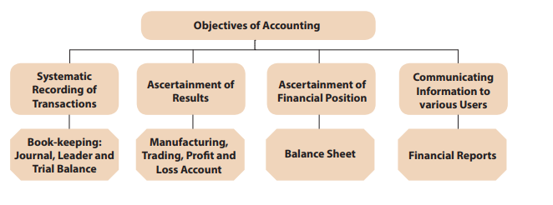
Overview of Objectives of Accounting

Slide 26
Advantages of Accounting
Maintenance of business records
Preparation of financial statements
Comparison of results
Decision making
Evidence in legal matters
Provides information to related parties
Helps in taxation matters
Valuation of business
Replacement of memory

Slide 27
Limitations of Accounting
Measurability
Some very important qualities like management, loyalty, reputation, etc. find no place in the financial statements of a company.
No Future Assessment
The financial statements show the financial position of the firm on the date of preparation. The users of the statement are more interested in the future of the company in the short term and long term. However, accounting does not make any such estimates.

Slide 28
Historical Costs
Accounting often uses historical costs to measure the values. This fails to take into consideration factors such as inflation, price changes, etc. This skews the relevance of such accounting records and information.

Slide 29
Accounting Policies
There is no global standard in accounting policies. In India, we follow the Accounting Standards. Americans follow the GAAP and then there are the international standards, namely the IFRS. And if a global company operates in more than one country, there may be confusion.
Not all accounting policies follow the same line of thinking, and conflicts may arise due to this. It has long been said that the whole world must agree on uniform accounting policies but this has not happened yet.

Slide 30
Estimates
Sometimes in accounting estimation may be required as it is not possible to establish exact amounts. But these estimates will depend on the personal judgment of the accountant. And estimates are extremely subjective in nature. They are basically a person’s guess of future events. In accounting, there are many cases where such estimates need to be made like provision of doubtful debt, methods of depreciation, etc.

Slide 31
Verifiability
An audit of the financial statements does not guarantee the correctness of such statements. The auditor can only assure that the statements are free from error to the best of his judgment.

Slide 32
Errors and Frauds
Accounting is done by humans, so there will always be the scope of human errors. There is also the fear of possible manipulation of accounts to cover up a fraud. Since fraud is deliberate, it is that much harder to spot. This is one of the most dreaded limitations of accounting.

Slide 33

CONFUSED!
ANY OR ONLY QUESTIONS?

Slide 34
THANK YOU
11

